Slide 1
Bakery sales predictions
Karolina and Tobias Saegner
09 01 2025
Kiel

Slide 2
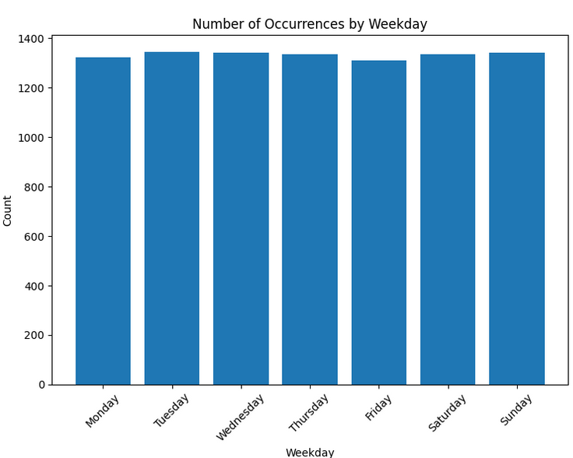
Self-made variables
Day of the week (Monday – Sunday)
Day_0 … Day_7; type – Boolean

Slide 3
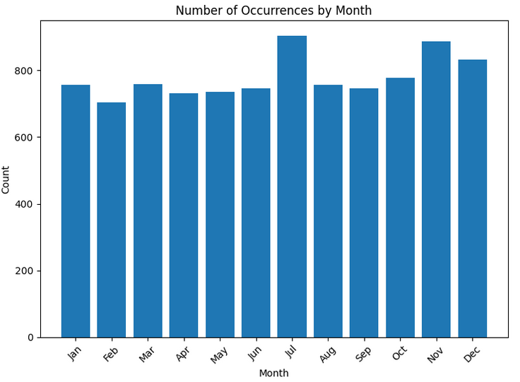
Self-made variables
Month (January – December)
Month_1 … Month_12; type – Boolean

Slide 4
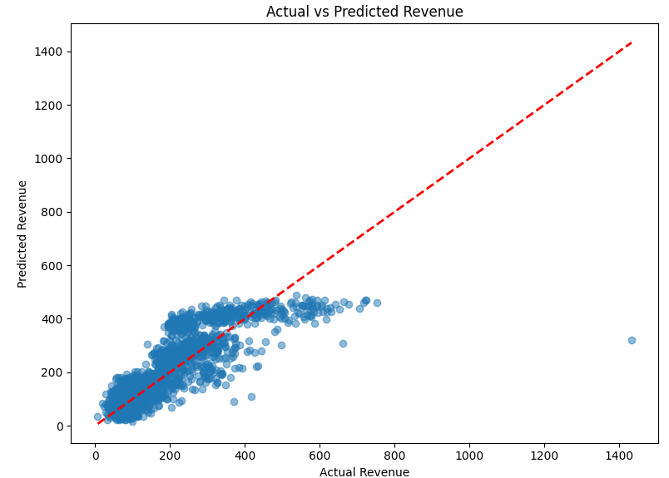
Optimierung des linearen Modells: Modellgleichung und adjusted r²
Umsatz = 180.56 - 6.62*Bewoelkung + 1.34*Windgeschwindigkeit + 2.28*Wettercode + 5.10*KielerWoche + 19.02*DayOfWeek + 4.11*Month - 68.57*Warengruppe_1 + 220.69*Warengruppe_2 - 25.76*Warengruppe_3 - 101.39*Warengruppe_4 + 90.99*Warengruppe_5 - 115.96*Warengruppe_6 - 14.30*Temperatur_binned_Mild - 12.87*Temperatur_binned_Warm + 1.40*Temperatur_binned_Hot + 15.09*Temperatur_binned_Cool - 20.82*Temperatur_binned_Cold + 31.50*Temperatur_binned_Very Cold
Adjusted R²: 0.6668

Slide 5
Art der Missing Value Imputation
KNN

Slide 6
Optimierung des neuronalen Netzes
Source Code zur Definition des neuronalen Netzes
# Tensorflow
model = tf.keras.Sequential([
# Long Short-Term Memory (LSTM) layer w/ 128 units and a ReLU activation function
LSTM(128, activation='relu', input_shape=(1, X_train_seq.shape[2])),
Dropout(0.3),
Dense(64, activation='relu’),
Dropout(0.2),
# Final output: predicted sales value
Dense(1)
])
Notes:
LSTM(128, activation='relu', input_shape=(1, X_train_seq.shape[2])): This defines the first layer, which is a Long Short-Term Memory (LSTM) layer with 128 units and a ReLU activation function. The input shape is set to (1, X_train_seq.shape[2]), which means the model expects a sequence of length 1 with the same number of features as the training data.
Dropout(0.3): This adds a dropout layer with a dropout rate of 0.3 to the model, which helps prevent overfitting.
Dense(64, activation='relu'): This adds a dense (fully connected) layer with 64 units and a ReLU activation function.
Dropout(0.2): Another dropout layer with a dropout rate of 0.2.
Dense(1): The final dense layer with a single output unit, which represents the predicted sales value.

Slide 7
Optimierung des neuronalen Netzes
Darstellung der Loss-Funktionen für Trainings- und Validierungsdatensatz
# mean squared error
model.compile(optimizer='adam', loss='mse', metrics=['mean_absolute_percentage_error'])
callbacks = [
EarlyStopping(monitor='val_loss', patience=20, restore_best_weights=True),
ModelCheckpoint('best_model.keras', monitor='val_loss', save_best_only=True)]
history = model.fit(
X_train_seq, y_train_seq,
epochs=150,
batch_size=32,
validation_data=(X_val_seq, y_val_seq),
callbacks=callbacks,
verbose=1)
Notes:
The model is compiled with the following settings:
optimizer='adam': The Adam optimization algorithm is used to update the model's weights during training.
loss='mse': The mean squared error (MSE) loss function is used to measure the difference between the predicted and actual sales values.
metrics=['mean_absolute_percentage_error']: (MAPE) metric is used to evaluate the model's performance during training and validation.
The callbacks list includes two important callbacks:
EarlyStopping(monitor='val_loss', patience=20, restore_best_weights=True): This callback monitors the validation loss and stops the training if the validation loss does not improve for 20 epochs. It also restores the weights of the best-performing model.
ModelCheckpoint('best_model.keras', monitor='val_loss', save_best_only=True): This callback saves the best-performing model (based on the validation loss) to the file 'best_model.keras'.
The model.fit() function is called to train the model. It takes the following arguments:
X_train_seq and y_train_seq: The training input and target data.
epochs=150: The number of training epochs.
batch_size=32: The batch size used during training.
validation_data=(X_val_seq, y_val_seq): The validation input and target data.

Slide 8
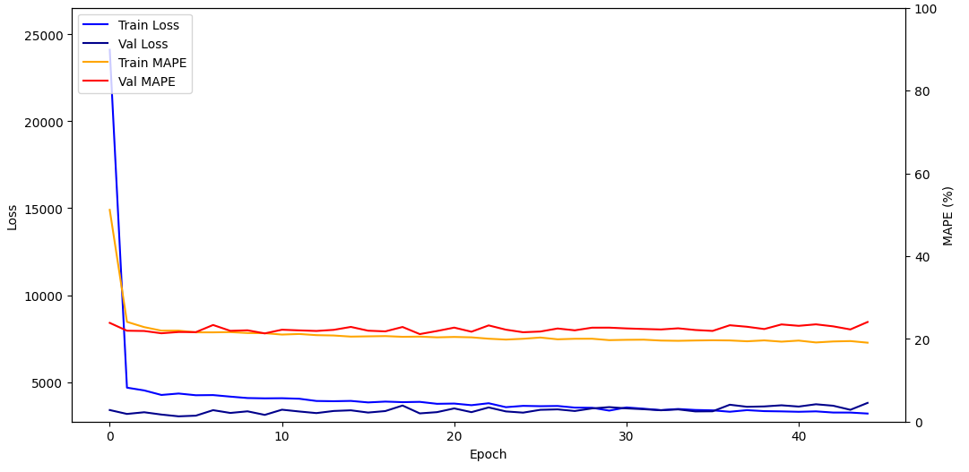
Optimierung des neuronalen Netzes
Validation dataset MAPE = 21.65%

Slide 9
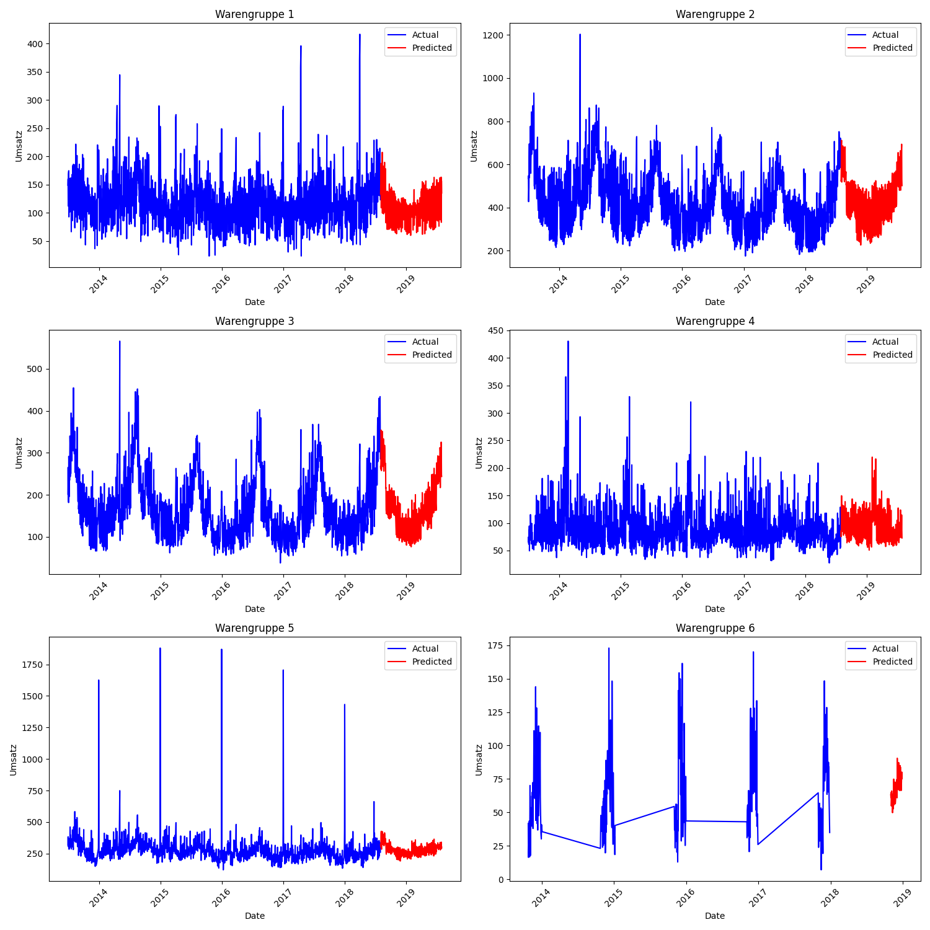
Warengruppen MAPEs
20.9%
18.6%
19.4%
25.4%
17.2%
50.1%

Slide 10
Worst Fail / Best Improvement
Worst fail: insufficient data inspection/visualization
“Hey Steffen, kann es sein, dass da Daten fehlen?”
Warengruppe 6 (MAPE 50%)
Best improvement: learning rate scheduler
def lr_schedule(epoch, lr):
initial_lr = 0.01 # Start with this learning rate
decay_rate = 0.1 # Decay rate
decay_steps = 10 # Epochs after which to decay
return initial_lr * np.exp(-decay_rate * (epoch / decay_steps))

